Slide 1
病歷管理系統
組別：第9組
組長：108598005鍾宜舫
組員：108598052游上逸 108598057鮑勇志
108598043楊智成
108598042白庭愷
108598065陳昭銘

Slide 2
Outline
Personal evaluation to project contributions
Analysis and Design Models
Overall Project Deliverables
Change History
Evaluation to Consistency of Design and Implementation
Project retrospective
Implementation
Notes:
對項目的個人評價
分析和設計模型
總體項目交付
改變歷史
評估設計和執行一致性
專案回顧
執行

Slide 3

Medical Record Management System
Personal evaluation to project contributions
鍾宜舫
軟體架構、專案討論、專案進度監督、軟體撰寫、 Front - end
Analysis and Design Models
游上逸
軟體架構、專案討論、軟體撰寫、錯誤修正、軟體介面、 Back - end
Overall Project Deliverables
白庭愷
軟體架構、專案討論、資料庫、軟體撰寫、軟體規劃、Back - end
Change History
鮑勇志
軟體架構、軟體討論、軟體撰寫、軟體開發文件、Front - end
Evaluation to Consistency of Design and Implementation
Project retrospective
陳昭銘
軟體架構、軟體討論、軟體撰寫、軟體開發文件、 Back - end
楊智成
軟體架構、軟體討論、軟體撰寫、軟體開發文件、Back - end
Implementation
Notes:
這是每個人的分工圓餅圖以及所負責的任務
但大多數都是大家共同參與討論

Slide 4
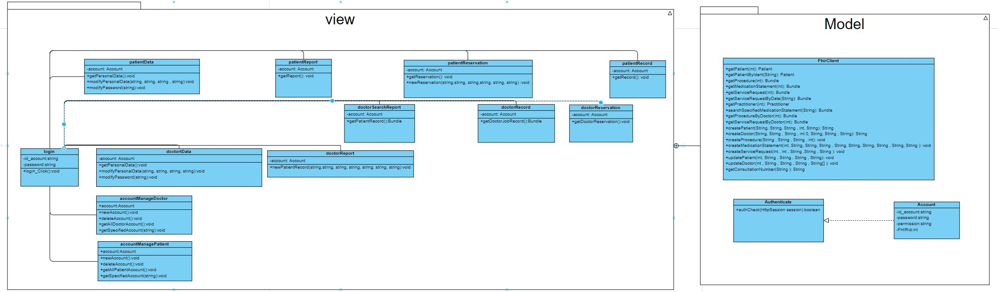
Medical Record Management System
Class Diagram
Personal evaluation to project contributions
Analysis and Design Models
Overall Project Deliverables
Change History
Evaluation to Consistency of Design and Implementation
Project retrospective
Implementation
Notes:
工作分工解構圖

Slide 5
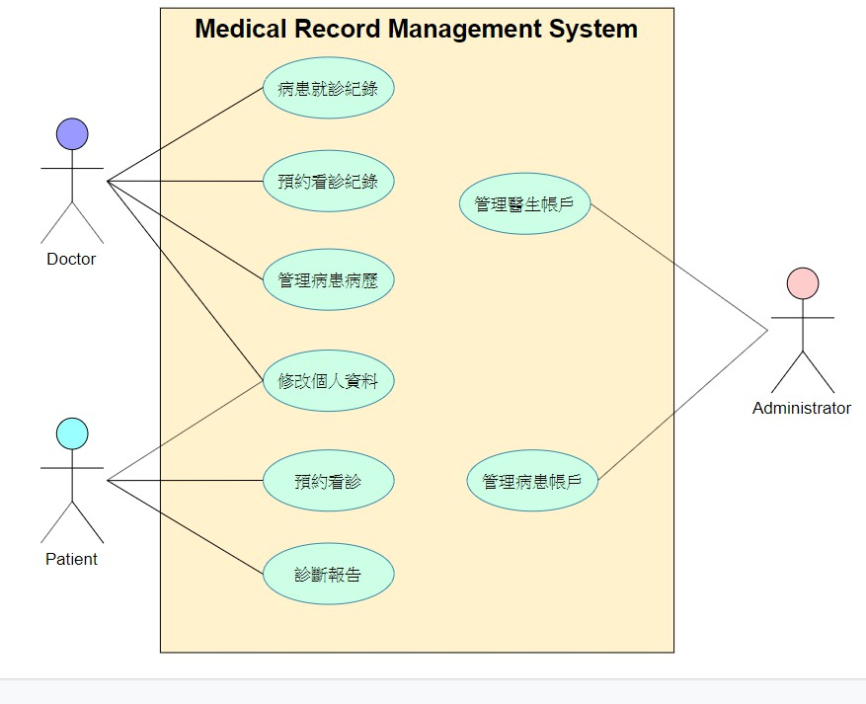
Medical Record Management System
Use Case Diagram
Personal evaluation to project contributions
Analysis and Design Models
Overall Project Deliverables
Change History
Evaluation to Consistency of Design and Implementation
Project retrospective
Implementation
Notes:
工作分工解構圖

Slide 6
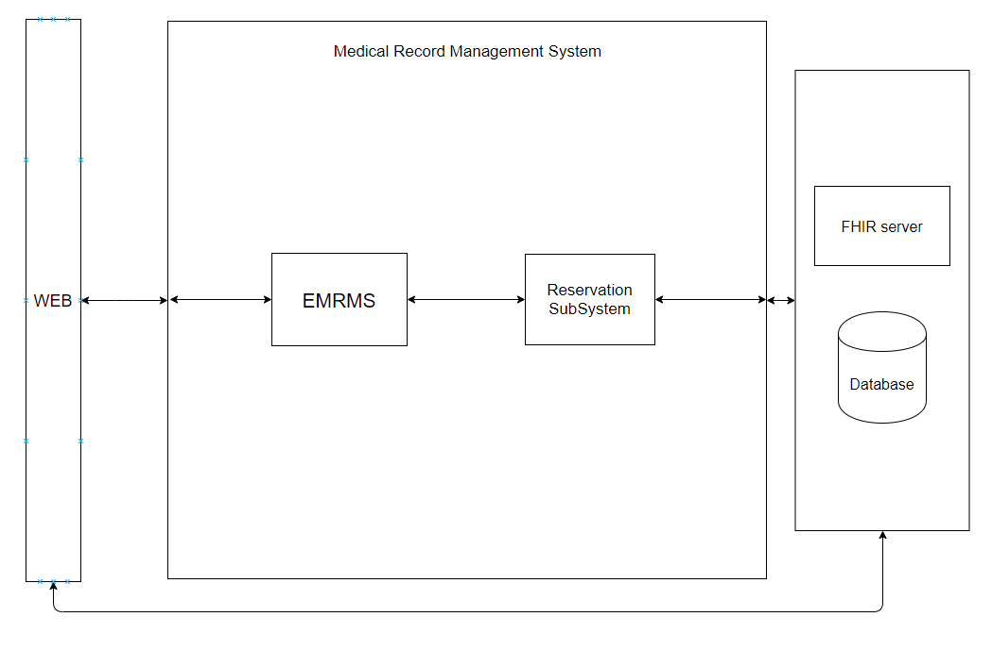
Medical Record Management System
System Block Diagram
Personal evaluation to project contributions
Analysis and Design Models
Overall Project Deliverables
Change History
Evaluation to Consistency of Design and Implementation
Project retrospective
Implementation
Notes:
工作分工解構圖

Slide 7
Medical Record Management System
Deliverables | 預計交付時間 | 實際交付時間
PEP 文件 | 2019/10/09 | 2019/10/08
SRS + Prototyping | 2019/10/30 | 2019/10/29
使用者身份與權限認證 | 2019/11/09 | 2019/11/10
病歷管理子系統 | 2019/12/08 | 2019/12/10
PPT 投影片 | 2019/12/25 | 2019/12/25
專案遞交 | 2020/01/08 | -
SDD 文件 | 2020/01/08 | -
STD 文件 | 2020/01/08 | -
Personal evaluation to project contributions
Analysis and Design Models
Overall Project Deliverables
Change History
Evaluation to Consistency of Design and Implementation
Project retrospective
Implementation
Notes:
整體交付成果

Slide 8
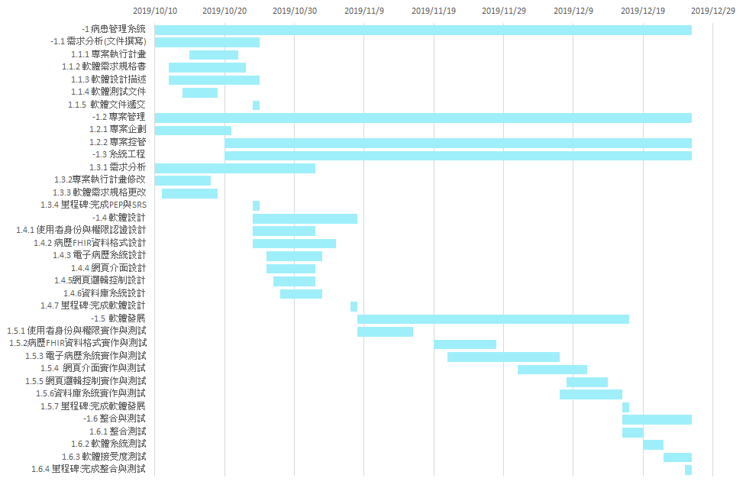
Medical Record Management System
Task Scheduling
Personal evaluation to project contributions
Analysis and Design Models
Overall Project Deliverables
Change History
Evaluation to Consistency of Design and Implementation
Project retrospective
Implementation

Slide 9
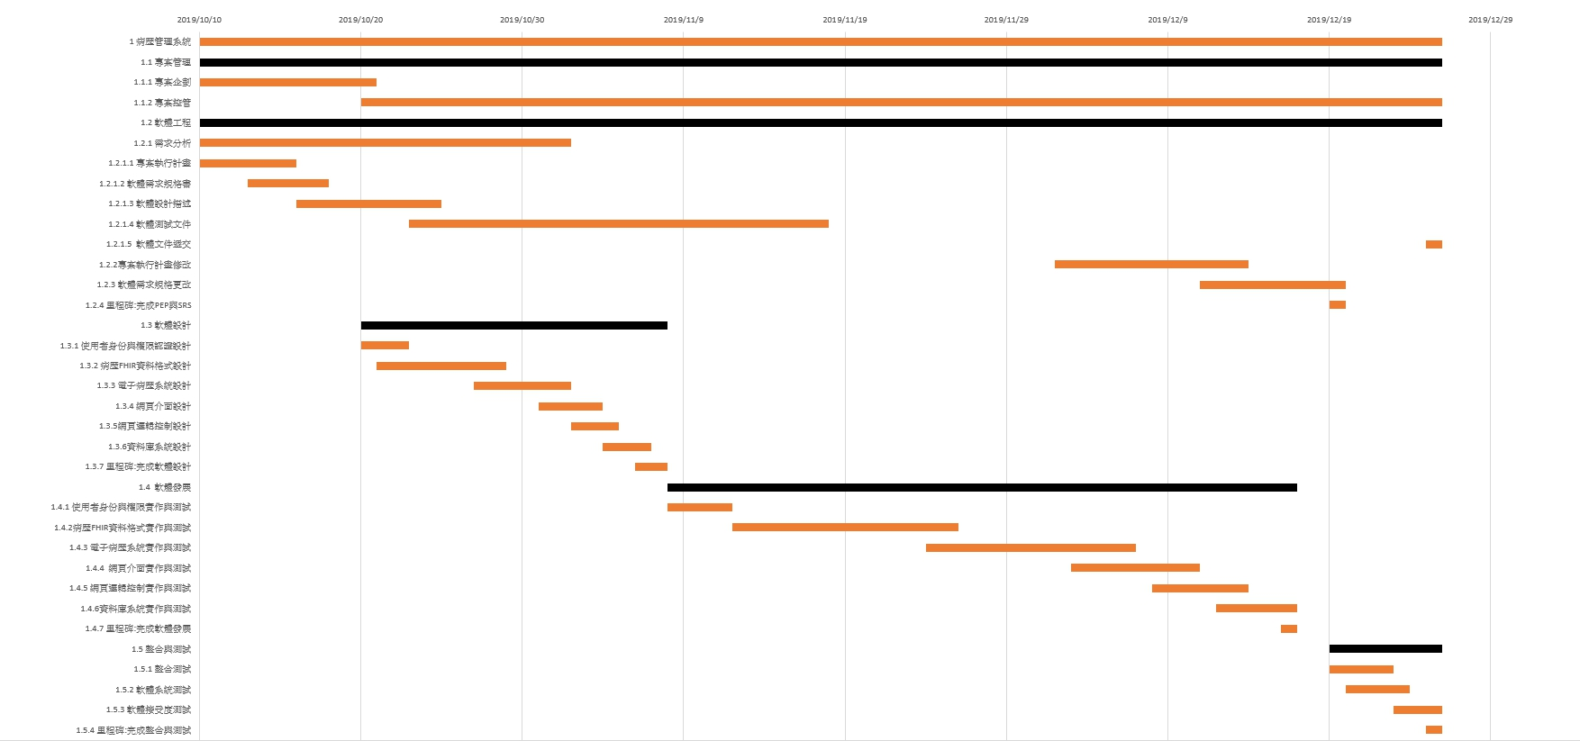
Medical Record Management System
Task Scheduling
Personal evaluation to project contributions
Revised
Analysis and Design Models
Overall Project Deliverables
Change History
Evaluation to Consistency of Design and Implementation
Project retrospective
Implementation

Slide 10
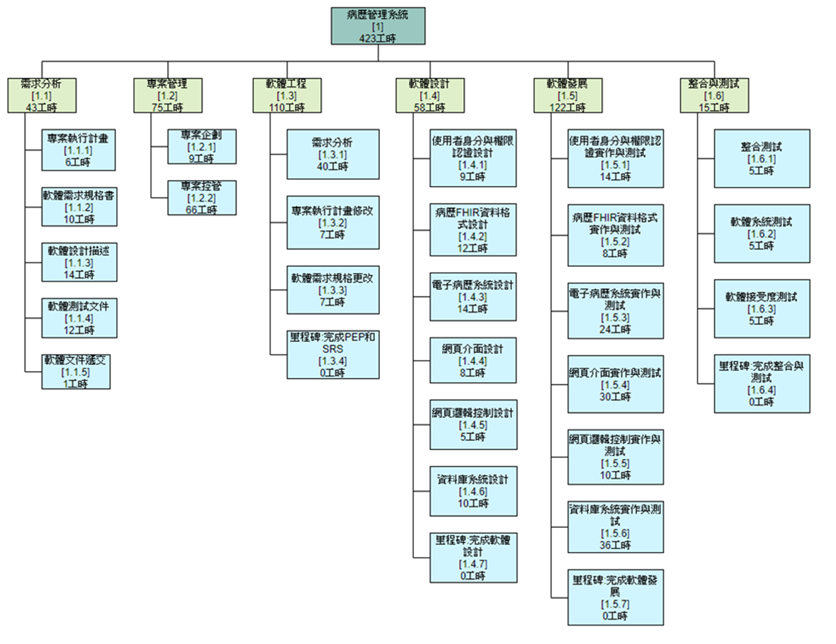
Medical Record Management System
WBS
Personal evaluation to project contributions
Analysis and Design Models
Overall Project Deliverables
Change History
Evaluation to Consistency of Design and Implementation
Project retrospective
Implementation

Slide 11
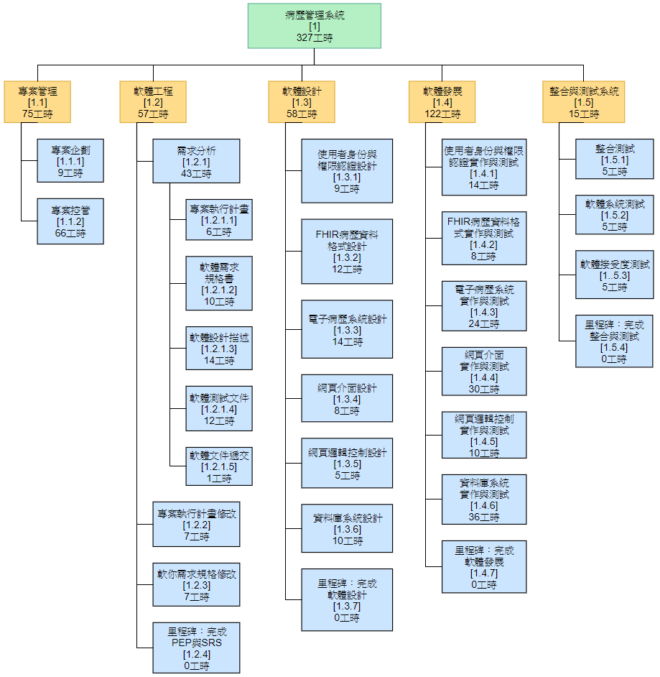
Medical Record Management System
WBS
Personal evaluation to project contributions
Revised
Analysis and Design Models
Overall Project Deliverables
Change History
Evaluation to Consistency of Design and Implementation
Project retrospective
Implementation

Slide 12
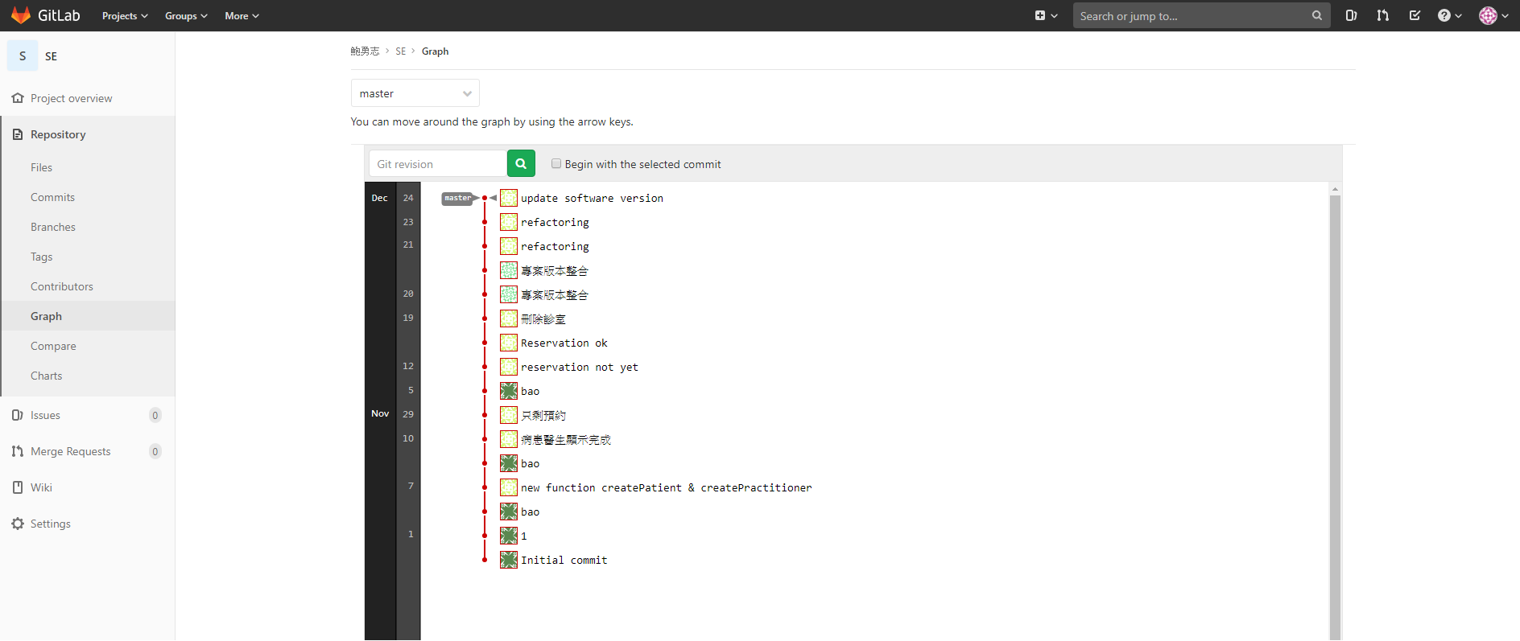
Medical Record Management System
Personal evaluation to project contributions
Analysis and Design Models
Overall Project Deliverables
Change History
Evaluation to Consistency of Design and Implementation
Project retrospective
Implementation

Slide 13
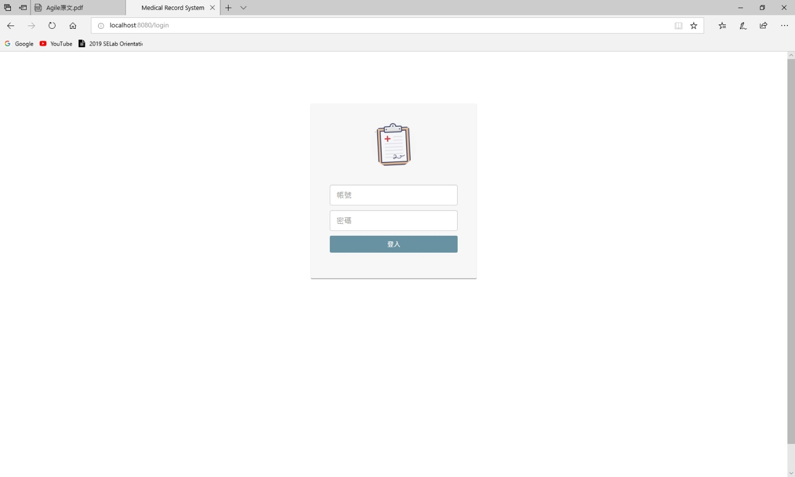
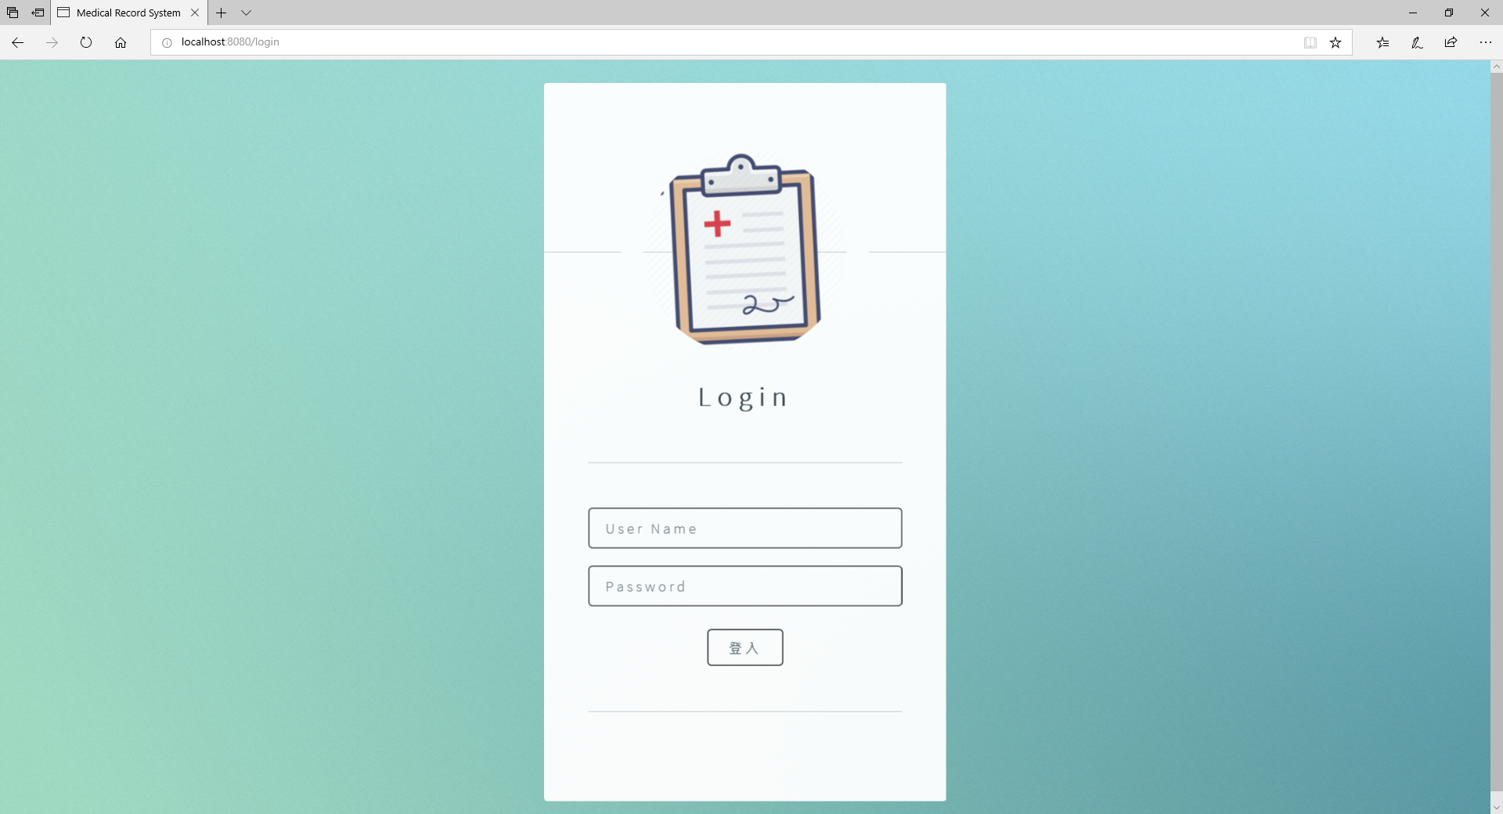
Medical Record Management System
Personal evaluation to project contributions
Analysis and Design Models
Overall Project Deliverables
Change History
Evaluation to Consistency of Design and Implementation
Project retrospective
Implementation

Slide 14
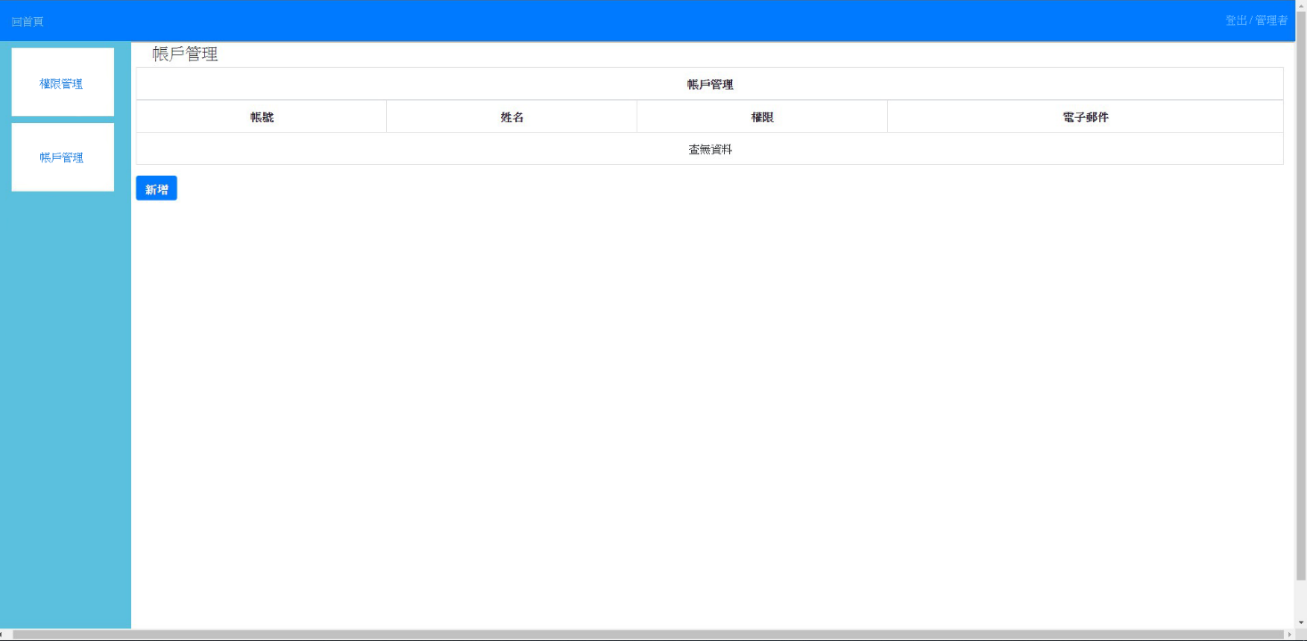
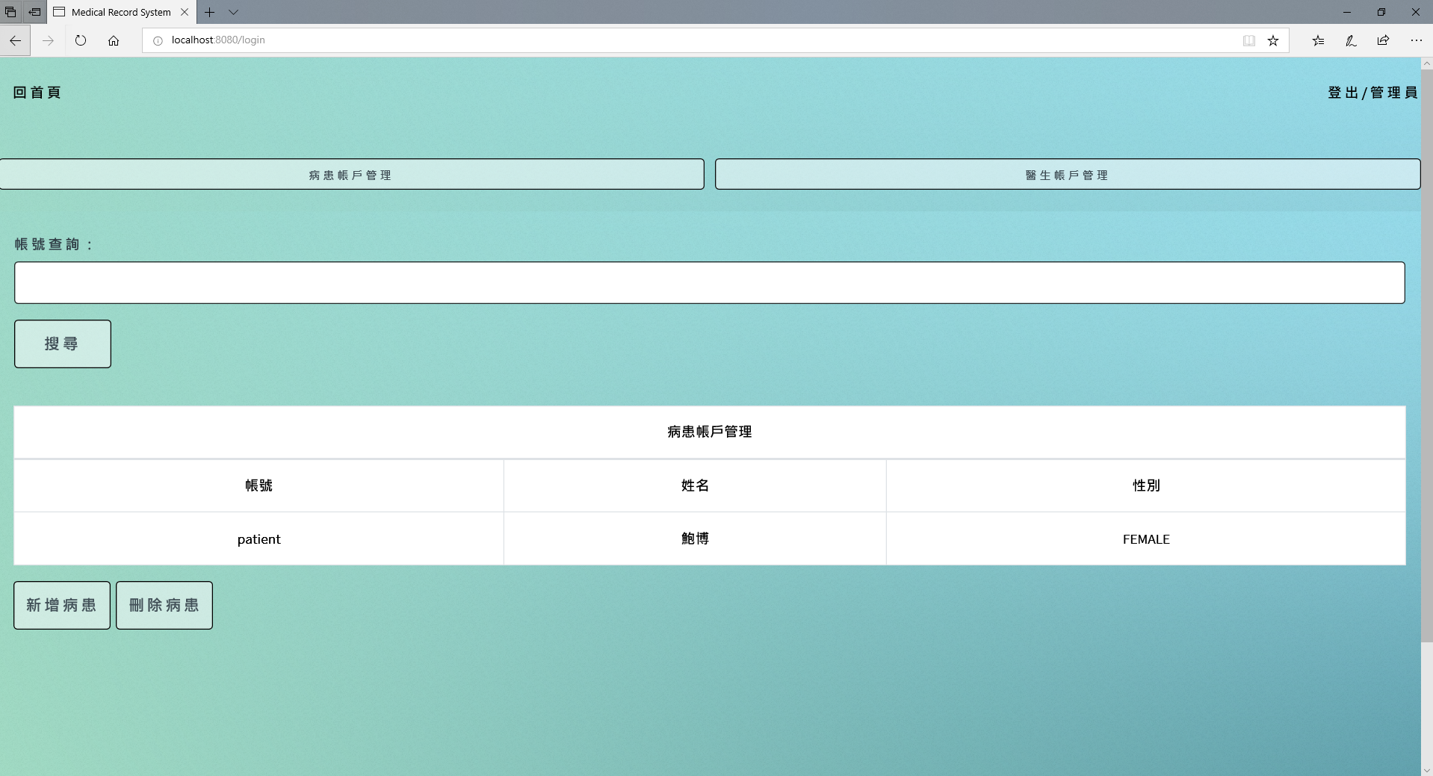
Medical Record Management System
Personal evaluation to project contributions
Analysis and Design Models
Overall Project Deliverables
Change History
Evaluation to Consistency of Design and Implementation
Project retrospective
Implementation

Slide 15
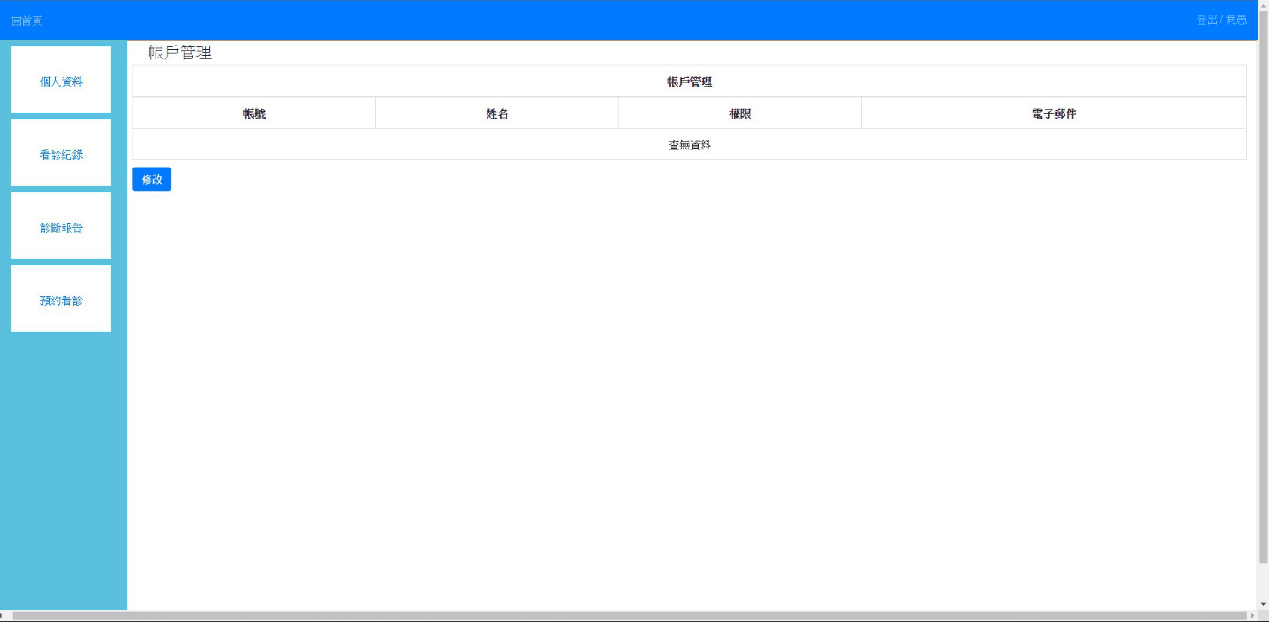
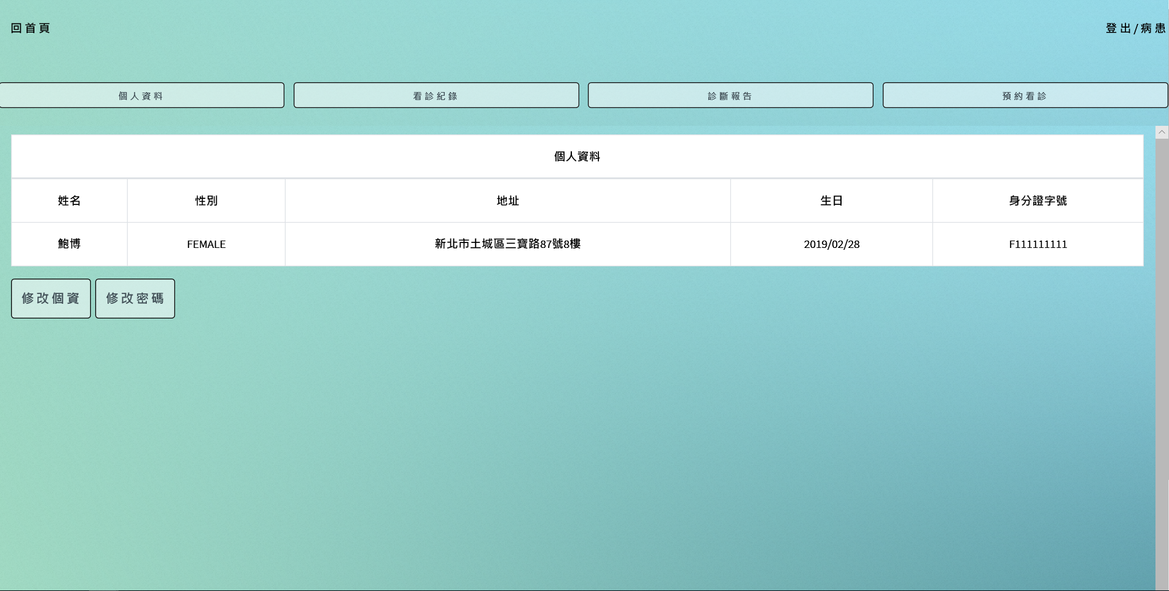
Medical Record Management System
Personal evaluation to project contributions
Analysis and Design Models
Overall Project Deliverables
Change History
Evaluation to Consistency of Design and Implementation
Project retrospective
Implementation

Slide 16

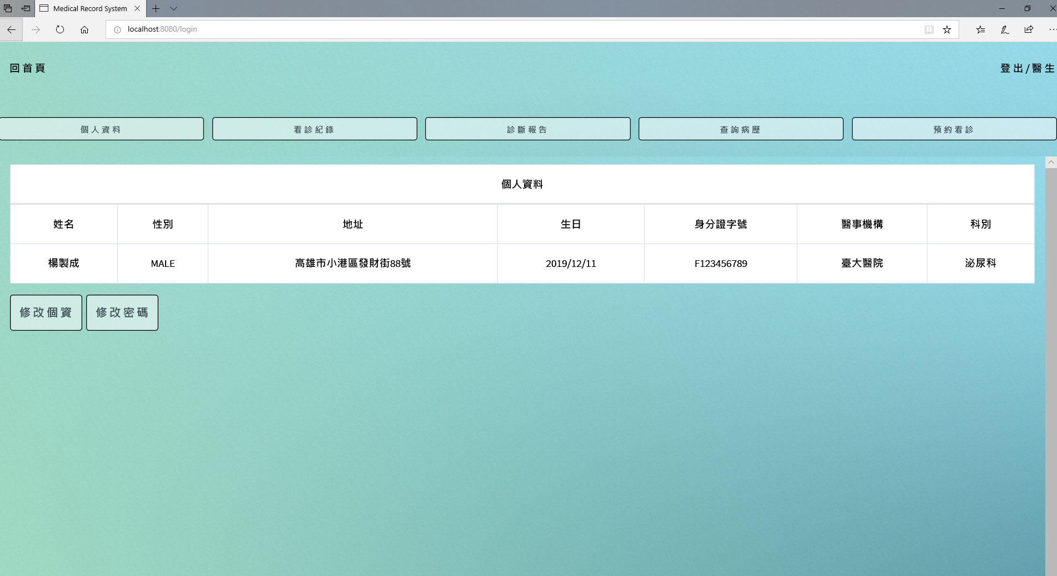
Medical Record Management System
Personal evaluation to project contributions
Analysis and Design Models
Overall Project Deliverables
Change History
Evaluation to Consistency of Design and Implementation
Project retrospective
Implementation

Slide 17
Medical Record Management System
Personal evaluation to project contributions
Better | Could be better
1.組員參與討論 2.團隊分工 3.版本控制 | 1.任務時間分配不當 2.設計與實作略微不同 3.測試案例不足 4.需去除Code Smell
Analysis and Design Models
Overall Project Deliverables
Change History
Evaluation to Consistency of Design and Implementation
Project retrospective
Implementation
Notes:
優點：
學習到軟體開發中所需要注意的地方及技術
參與討論
好的留下
缺點：
那些可以再改善

Slide 18
Medical Record Management System
Demo
Personal evaluation to project contributions
Analysis and Design Models
Overall Project Deliverables
Change History
Evaluation to Consistency of Design and Implementation
Project retrospective
Implementation

